Slide 1



PRESENTED BY
ELECTRO – PSYCHS
BATCH MEMBERS :
RITHISH KANNAN J
NITISH SARAN R
PRASANNA VENKATESH V R
SANTHOSH PERUMAL S

Slide 2

AUTOMATIC RAILWAY GATE CONTROLLER USING PIC16F877A :

Slide 3

TABLE OF CONTENTS :
ABSTRACT
INTRODUCTION
IMPORTANCE OF RAILWAY GATES
DRAWBACKS OF MANNED RAILWAY GATE CONTROL SYSTEMS
HARDWARES USED
SOFTWARES USED
PIC16F877A
BLOCK DIAGRAM
WORKING
ADVANTAGES

Slide 4
ABSTRACT :
The abstract of this project is to provide an automatic railway gate at a level crossing replacing the gates operated by the gatekeeper.
It deals with two things. Firstly, it deals with the reduction of time for which the gate is being kept closed, and secondly, to provide safety to the road users by reducing the accidents.
By the presently existing system once the train leaves the station, the stationmaster informs the gatekeeper about the arrival of the train through the telephone. Once the gatekeeper receives the information, the closes the gate depending on the timing at which the train arrives.
Hence, if the train is late due to certain reasons, then gate remain closed for a long time causing traffic near the gates.
By employing the automatic railway gate control at the level crossing the arrival of the train is detected by the sensor placed near to the gate. Hence, the time for which it is closed is less compared to the manually operated gates and also reduces the human labour.
This type of gates can be employed in an unmanned level crossing where the chances of accidents are higher and reliable operation is required. Since, the operation is automatic; error due to manual operation is prevented.
Automatic railway gate control is highly economical microcontroller based arrangement, designed for use in almost all the unmanned level crossings in the country.

Slide 5

INTRODUCTION :
Rail road is transition mode, which has an important role in moving passengers, freights. However, railroad related accidents are more dangerous than other transportation accidents. Therefore, more efforts are necessary for improving its safety. This system is to manage the control system of railway gate automatically using microcontroller. The main purpose of this system is about railway gate control system and level crossing between railroad and highway for decreasing railroad-related accident and increasing safety. This system is designed using PIC 16F877A microcontroller to avoid railway accidents happening at railway gates where the level crossings. Microcontroller performs the complete operation i.e., sensing, gate closing and opening. As a train approaches the railway crossing from either side, the sensors placed at a certain distance from the gate detects the approaching train and controls the operation of the gate. This system was operated after signal received from the sensors. This signal is used to trigger the microcontroller for operating the gate motor, alarm system and light indicators. This system also can be used in parking gate controlling and sliding door system. The abstraction of this system is to provide the advanced control system available everywhere.

Slide 6
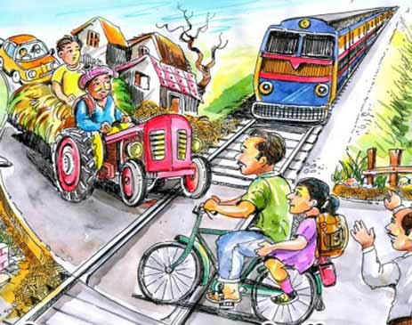
IMPORTANCE OF RAILWAY GATES:
Gated crossings became commonplace in many areas, as they protected the railway from people trespassing and livestock, and they protected the users of the crossing when closed by the signalman/gateman.

Slide 7
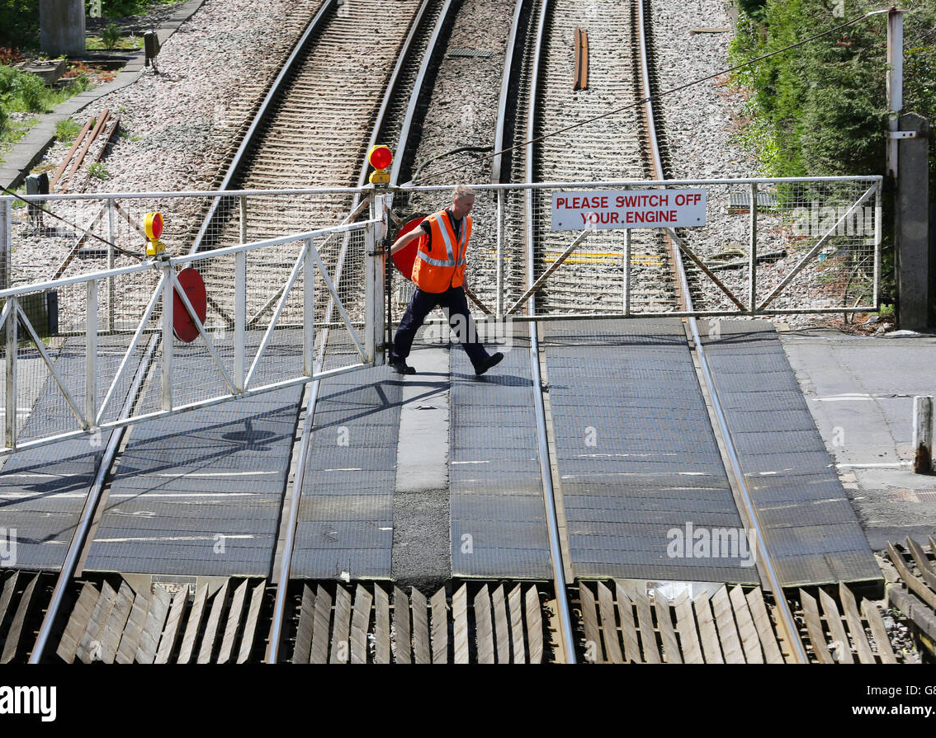
DRAWBACKS OF MANNED RAILWAY GATE CONTROL SYSTEM :
Manned rail crossings need a lot of man power to do the job of signalling and operating the barrier. So, manned rail crossings are not cost efficient.
Most of the time this procedure is not time efficient. Often train arrives a long time after the gates has been closed.
Manned system is erroneous, and can cause severe damage which may worth a heavy loss of life and capital.

Slide 8

HARDWARES USED :
PIC16F877A - MICROCONTROLLER
IR SENSORS
LCD DISPLAY
TRAFFIC LIGHT MODULE
SERVO MOTORS

Slide 9
SOFTWARES USED :
MP LAB IDE :
MPLAB X Integrated Development Environment (IDE) is an expandable, highly configurable software program that incorporates powerful tools to help you discover, configure, develop, debug and qualify embedded designs for most of our microcontrollers and digital signal controllers. MPLAB X IDE works seamlessly with the MPLAB development ecosystem of software and tools, many of which are completely free.

Slide 10
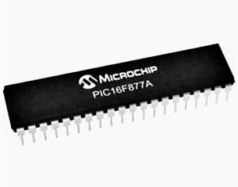
PIC16F877A – MICROCONTROLLER :
The PIC16F877A is a 40-pin (DIP) microcontroller which Microchip describes as powerful based on having a 200 nanosecond instruction speed.
PIC16F877a is a PIC Microcontroller and is normally used in Embedded Projects like Home Automation System, Bank Security System etc.
The PIC16F887 is an 8-bit microcontroller from Microchip. The 40-pin IC has 14 Channel 10-bit ADC making it suitable for applications which require more ADC inputs. The IC also has 2 Comparators, 2 Timers (8-bit and 16-bit) and supports SPI, I2C and UART communication protocols.

Slide 11

LCD DISPLAY
BLOCK DIAGRAM :
TRAFFIC LIGHT 1
TRAFFIC LIGHT 2
PIC16F877A
MICROCONTROLLER
PRESSURE SENSOR 1
PRESSURE SENSOR 2
GATE1
MOTOR 1
INPUT
OUTPUT
MOTOR 2
GATE 2

Slide 12

WORKING :
When the train enters at the particular distance( i.e.,1km ), the sensors detects the train and the traffic signal turns to red and the gate closes and then the information( TRAIN REACHING ) is shown in the display.
After the train crosses the gate and then detects through the sensor2, the traffic signal turns to green and the gate will open. Meanwhile, the information( TRAIN LEFT ) is shown in the display.

Slide 13

ADVANTAGES OF AUTOMATIC RAILWAY GATE CONTROLLER :
Avoid man power.
Reduce operation costs.
Easy to use.
Performance is high.
Portable.
Accuracy is high.
Automatic operation.
Low power consumption.
Traffic light is installed to avoid traffic jam and accidents.

Slide 14


